Slide 1
Object Oriented Design & Programming
Unit-9
Templates & Exception Handling OODP

Slide 2
🞄 It provide support for generic programming.
🞄 Using Template we can generate generic class and function.
🞄 Generic programming is an approach where generic types are used as parameters in algorithms so that they work for a variety of suitable data types and data structure.
🞄 The simple idea is to pass data type as a parameter so that we don’t need to write same code for different data types.
🞄 For example we may need sort() function for different data types. Rather than writing and maintaining the multiple codes, we can write one sort() function and pass data type as a parameter.
What is Template?

Slide 3
🞄 Template is defined with the parameter, that would be replaced by a specified data type at a time of actual use of the class or function.
🞄 Template can be considered as a kind of macro.
What is Template?
🞄 Templates are sometimes called parameterized classes or
functions.
🞄 Templates are used for code reusability.

Slide 4

🞄 Templates are expanded at compiler time.
template<typename T>
T myMax(T x, T y)
{
return (x>y)?x:y;
}
int main()
{
cout<<myMax<int>(3,4)<<endl; cout<<myMax<float>(6.4,9.2)<<endl; cout<<myMax<char>('g','e')<<endl;
}
Compiler internally generates
and adds below code
int myMax(int x, int y)
{
return (x>y)?x:y;
}
How templates work?
float myMax(float x, float y)
{
return (x>y)?x:y;
}
char myMax(char x, char y)
{
return (x>y)?x:y;
}

Slide 5
🞄 How to declare a function template?
🞄 A single function template can work with different data types at once.
Function Template
🞄 template<class T> //instead of class we can use typename
keyword also.
T someFunction(T arg)
{
... .. ...
}

Slide 6
generic class operations.
🞄 Like function templates, you can also create class templates for
🞄 How to declare a class template?
template <class T>
class className
{
... .. ...
public:
T var;
T someOperation(T arg);
... .. ...
};
Class Template

Slide 7
🞄 className<datatype> classObject;
🞄 How to create a class template object?
Class Template
🞄 For Example:
className<int> classObject;
className<float> classObject;

Slide 8

Class Template
#include<iostream> using namespace std; template <class T> class Calculator { T num1, num2; public: Calculator(T n1, T n2) { num1 = n1; num2 = n2; } void display() { cout<<"Addition is: " << add() << endl; } T add() { return (num1 + num2); } }; | int main() { Calculator<int > iC(2,1); Calculator<float> fC (2.4,1.2); cout<<"Int results:" << endl; iC.display(); cout<<"Float results:" << endl; fC.display(); return 0; }

Slide 9

template<class T> void fun(T x, T y)
{
cout<<"In Template Function" << endl;
}
void fun(int a, int b)
{
cout<<"In Non template" << endl;
}
int main()
{
fun(1,2);
fun(1.5,5.6);
fun('a', 'b');
fun(1,'b');
}
Overloading Template Function

Slide 10

Template and Inheritance
template<class T> class one { public: T x; one(T a) { x=a; cout<<"In Parent"<<endl; cout<<"x="<<x<<endl; } }; template<class T> class two : public one<T> { public: two(T x):one<T>(x) { cout<<"In Child"<<endl; } }; | int main() { two<int> o1(2); two<float> o2(1.1); return 0; }

Slide 11
🞄 Check the output by giving b=0;
#include <iostream>
using namespace std;
int main()
{
int a,b,c;
cout<<"Enter value of a and
b"<<endl;
cin>>a>>b;
c=a/b;
cout<<"Result is="<<c;
return 0;
}
Exception Handling Need

Slide 12
🞄 Exception handling is the process to manage the runtime errors by converting the abnormal termination of a program to normal termination of program.
🞄 Run time errors are known as Exception.
Exception Handling in C++
🞄 An exception is a problem that arises during the execution of a program.
🞄 For Example: Divide by Zero

Slide 13
🞄 C++ provides following specialized keywords for this
purpose.
try, catch and throw
🞄 try: represents a block of code that can throw an exception.
🞄 catch: represents a block of code that is executed when a
particular exception is thrown.
🞄 throw: Used to throw an exception. This is done using a
throw keyword.

Slide 14
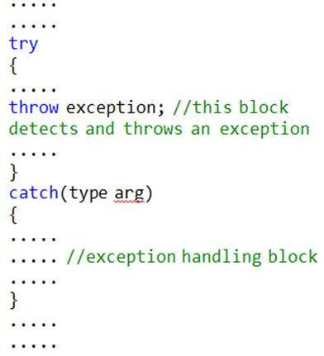
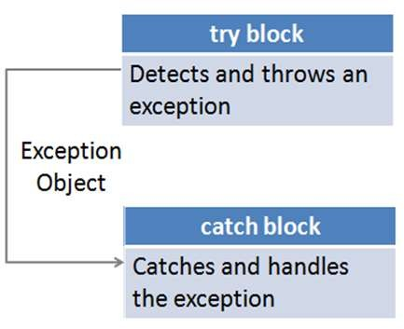
Exception Handling in C++

Slide 15
int main()
{
int a,b,c;
cout<<"Enter value of a and b"<<endl;
cin>>a>>b;
try
{
if(b!=0)
{
c=a/b;
cout<<"Result is="<<c;
}
else
throw(b);
}
catch(int x)
{
cout<<"Exception caught: Divide by 0\n";
}
return 0;
}
Exception Handling in C++

Slide 16
void test(int x)
{
try
{
if(x==10)
throw x; else
throw 'A';
}
catch(int x)
{
cout<< "Catch an integer";
}
catch(char x)
{
cout<< "\nCatch a character";
}
}
int main()
{
test(10);
test(65);
return 0;
}
Multiple catch

Slide 17
🞄 There is a special catch block called ‘catch all’ catch(…) that can be
used to catch all types of exceptions.
#include<iostream> using namespace std;
int main()
{
try
{
throw 'a';
}
catch(int x)
{
cout<< "Caught " << x;
}
catch(...)
{
cout<< "Default Exception \n";
}
return 0;
}
Catch all

Slide 18
thrown using “throw”
🞄 try-catch blocks can be nested. Also, an exception can be re-
int main()
{
try
{
try
{
throw 20;
}
catch(int n)
{
cout<<"Partially \n";
throw; //Re-throwing an exception
}
}
catch(int n)
{
cout<<"remaining ";
}
return 0;
}
Re-throw

Slide 19
🞄 The c++ STL (Standard Template Library) is a powerful set of c++ template classes to provides general purpose templatized classes and functions that implement many popular and commonly used algorithms and data structures like vectors, list, queues and stacks.
STL (Standard Template Library)
🞄 There are 3 core components of STL as follows:
Containers
Algorithms
Iterators
Reference: geeksforgeeks.org
studytonight.com

Slide 20
🞄 STL is a generic library , i.e a same container or algorithm can be operated on any data types , you don’t have to define the same algorithm for different type of elements.
🞄 Algorithms
🞄 Collection of Operations to perform specific task on contents of container.
🞄 For Example: sort
STL (Standard Template Library)
🞄 Containers
🞄 Container stores object and data.
🞄 For Example: vector, list
🞄 Iterators
🞄 It is used to work on sequential values.
Reference: geeksforgeeks.org
studytonight.com

Slide 21
🞄 STL provide number of algorithms that can be used of any container, irrespective of their type. Algorithms library contains built in functions that performs complex algorithms on the data structures.
Algorithms in STL
🞄 For example: one can reverse a range with reverse() function, sort a range with sort() function, search in a range with binary_search() and so on.
🞄 Algorithm library provides abstraction, i.e you don't necessarily need to know how the algorithm works.
Reference: geeksforgeeks.org
studytonight.com

Slide 22
create data structures like arrays, linked list, trees etc.
🞄 Container library in STL provide containers that are used to
Containers in STL
🞄 These container are generic, they can hold elements of any data types, for example: vector can be used for creating dynamic arrays of char, integer, float and other types.
Reference: geeksforgeeks.org
studytonight.com

Slide 23
🞄 Iterators in STL are used to point to the containers. Iterators
actually acts as a bridge between containers and algorithms.
Iterators in STL
🞄 For example: sort() algorithm have two parameters, starting iterator and ending iterator, now sort() compare the elements pointed by each of these iterators and arrange them in sorted order, thus it does not matter what is the type of the container and same sort() can be used on different types of containers.
Reference: geeksforgeeks.org
studytonight.com

Slide 24
🞄 array : replicates arrays
🞄 vector : replicates dynamic arrays
🞄 queue : replicates queues
🞄 stack : replicates stack
🞄 priority_queue : replicates heaps
🞄 list : replicates linked list
🞄 set : replicates trees
🞄 map : associative arrays
Containers
Reference: geeksforgeeks.org
studytonight.com

Slide 25
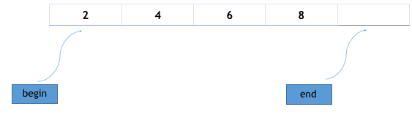
🞄 Syntax:
array<object_type, array_size> array_name;
🞄 Functions:
at()
front()
back()
fill()
empty()
size()
max_size()
begin()
end()
int main ()
{
array<int,10> array1 = {1,2,3,4,5,6,7,8,9};
cout << array1.at(2)<<endl;
cout << array1.at(4);
}
Array
Reference: geeksforgeeks.org
studytonight.com

Slide 26
🞄 An array works fine when we have to implement sequential data structures like arrays, except it is static, i.e. we have to define its maximum size during its initialization and it cannot contain elements greater than its maximum size.
Vector
🞄 Now what, if during the program execution we have to store
elements more than its size?
🞄 Solution of the above problem is dynamic arrays! They have
dynamic size, i.e. their size can change during runtime. Container library provides vectors to replicate dynamic arrays.
Reference: geeksforgeeks.org
studytonight.com

Slide 27
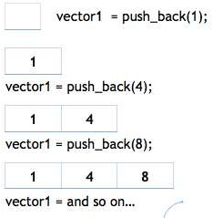
🞄 Syntax:
vector< object_type > vector_name;
🞄 Functions:
push_back()
insert()
pop_back()
erase()
resize()
swap()
clear()
size()
empty()
Vector
capacity()
at()
front() and back()
Reference: geeksforgeeks.org
studytonight.com

Slide 28
Vector
Function | Description
begin() | Returns an iterator pointing to the first element in the vector
end() | Returns an iterator pointing to the theoretical element that follows the last element in the vector
rbegin() | Returns a reverse iterator pointing to the last element in the vector (reverse beginning). It moves from last to first element
rend() | Returns a reverse iterator pointing to the theoretical element receding the first element in the vector (considered as reverse end)
size() | Returns the number of elements in the vector.
reverse() | Requests that the vector capacity be at least enough to contain n elements.
at(g) | Returns a reference to the element at position ‘g’ in the vector
front() | Returns a reference to the first element in the vector
back() | Returns a reference to the last element in the vector
push_back() | It push the elements into a vector from the back
pop_back() | It is used to pop or remove elements from a vector from the back.
insert() | It inserts new elements before the element at the specified position
erase() | It is used to remove elements from a container from the specified position or range.
Reference: geeksforgeeks.org
studytonight.com

Slide 29
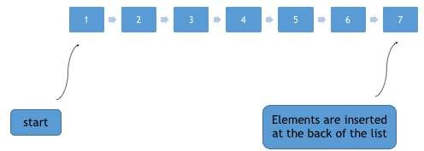
memory allocation.
🞄 Lists are sequence containers that allow non-contiguous
🞄 List is like doubly linked list.
🞄 Array and Vector are contiguous containers, i.e they store their data on continuous memory, thus the insert operation at the middle of vector/array is very costly (in terms of number of operation and process time) because we have to shift all the elements, linked list overcome this problem.
🞄 Linked list can be implemented by using the list container.
List
Reference: geeksforgeeks.org
studytonight.com

Slide 30
🞄 Iterators are used to point to the containers in STL, because of iterators it is possible for an algorithm to manipulate different types of data structures/Containers.
🞄 Algorithms in STL don’t work on containers, instead they work on iterators, they manipulate the data pointed by the iterators. Thus it doesn’t matter what is the type of the container and because of this an algorithm will work for any type of element and we don't have to define same algorithm for different types of containers.
Iterator
🞄 Syntax:
container_type <parameter_list>::iterator iterator_name;
Reference: geeksforgeeks.org
studytonight.com

Slide 31
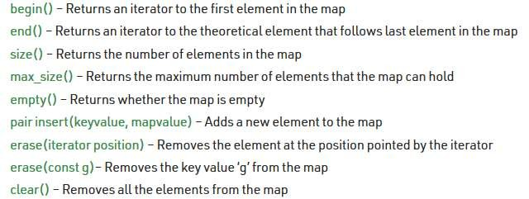
🞄 Maps are associative containers that store elements in a mapped fashion. Each element has a key value and a mapped value. No two mapped values can have same key values.
Map

Slide 32
Thank you

